Slide 1
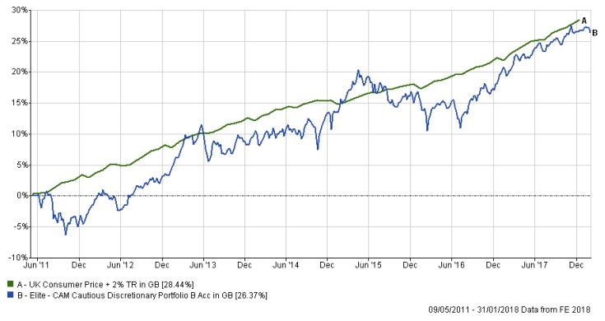
Elite CAM Cautious Discretionary Portfolio Fund January 2018
Information in this factsheet is at the last valuation point in January 2018 (except where indicated).
Investment Aims
The investment objective of the Fund is to provide a total return with an emphasis on providing capital appreciation. The portfolio will be actively managed and investments will be made on a multi asset basis with a portfolio of transferable securities (including investment trusts), collective investment schemes, deposits, money market instruments, derivatives and other alternative investments such as structured products, commodity and property funds. The investment manager has the absolute discretion to weight the portfolio towards any investment type or geographical and economic sector, including cash, at any time, provided such investment is compatible with the investment objective and policy of the Fund as a whole.
Benchmark
Consumer Price Index +2%
Fund Manager-FACET
FACET have been helping clients with their investments since 1985. Specialising in providing discretionary management services they currently run 4 in-house model portfolios. Historically FACET’s model portfolios have consistently outperformed numerous established benchmarks and comparable indices.
Fund Information (B share Class)
Fund Size £28.7m
Launch Date 0.05.11*
IA Sector Unclassified
OCF 2.05%**
AMC 0.75%
Initial/Exit Charge Nil
Min. Investment £1,000 lump sum
Domicile UK
Legal Structure OEIC (NURS)
Eligible for ISA Yes
Income Allocation 30 November
Sedol Codes B Acc. B3Q4TW1
B Inc. B687BC3
**the current AMC is 1.5% but FACET are rebating 0.75% and have applied to permanently reduce the AMC to 0.75%.
Contact Details
Issued by FACET Ltd, which is authorised and regulated by the Financial Conduct Authority. FRN: 131372.
Further Information can be obtained from:
FACET Limited
1-2 The Courtyard
East Park
Crawley, RH10 6AG
Sales: 01293 401293
Dealing: 0115 988 8284
Registered in England No 01931757
*FACET were appointed as Fund Adviser on the 28/11/2016 and as Manager on 10/02/2017
Fund Commentary
As from the 28 November, WM Capital Management were appointed as investment manager and sponsor of the Elite CAM Cautious and Balanced Discretionary Portfolio funds. They in turn appointed FACET as the investment adviser. As from 10th February 2017 FACET have been appointed as the investment manager. The fund continues to be managed in-line with the stated investment philosophy of FACET that strategic asset allocation is paramount to a well diversified portfolio, with underlying investment choice providing the outperformance.
The US stock market continued to drive up to new highs despite mixed economic data which saw only a modest rise in the closely watched yield on the 10-year Treasury bond. The US dollar weakened against both Sterling and the Euro where there was comparatively better UK economic data and an increasing likelihood of the Bank of England following US base rates higher. However, whilst the Euro economic data continues to recover, there have been cautious comments from the ECB indicating that any easing of easy monetary policy is as far off as late 2018 in order to safeguard against a collapse in the emergent rise in inflation which the ECB is keen to bring about. The UK’s FTSE100 Index touched a new high close to 7,800 towards the end of January but the relative strengthening of Sterling, up 7 cents to over $1.42 against the US dollar, impacted the export-heavy beneficiaries of the UK’s leading index which fell 3% from the highs, bringing the FTSE to a 2% loss for the month. The fund fell 0.50% in January.
Elite CAM Cautious Discretionary Fund Performance since launch
Source: Financial Express 09.05.2011 to 31.01.2018
Total Return, Bid to Bid, Tax UK Net. Past performance is not a reliable indicator of future results.
www.facteonline.co.uk

Slide 2
Introducing FACET
FACET’s Investment Philosophy
The FACET investment philosophy is very much a ‘top-down’ approach and they firmly believe that asset sector allocation will provide the majority of the performance with the underlying investment choice providing the critical alpha over their peers. They aim to utilise collectives for the majority of the asset allocation, with direct investments, mainly bonds, being bought as and when appropriate opportunities arise.
Key Portfolio Managers
John Richard Mitchell
John has over 40 year’s experience in the financial services industry. The primary focus for the last 15 years has been in the fixed income market. While he was employed as the risk manager for Credit Suisse Securities, he was involved in many areas, including risk control of bond trading, setting and controlling the VaR limits on the trading book and monitoring trades to ensure clients received best execution. When at Royal London Asset Management, he was involved in starting their first geared fund, set up the management of the risk control, and agreeing these with the trustee in order to get the sign off for the fund to go live. This fund held both bonds and equities together with written traded option to enhance the income on the equity holding. Involved in the set-up of Newland Financial as compliance director of both the stockbroking/Wealth Management arm and the fund managers. The fund managers had a specialist resources fund, the broker had a corporate finance department that brought mainly resources companies to the market.
Chris Fernyhough
Chris has been in the markets for almost 15 years now, 10 of which have been as a Wealth Manager, specialising in building multi-asset discretionary portfolios for High Net Worth and Corporate clients. These have consisted of both direct bond and equity exposure, as well as the use of collectives. Chris has worked for places such as WH Ireland, where he assisted in the set up and running of the Bristol office, and Newland Financial, where he set up their Wealth Management arm. Chris then moved to Beaufort Securities to assist in the set up of their stockbroking and Wealth Management arm. For the past three years, Chris has been the Managing Director of FACET who run bespoke discretionary money as well as model portfolios. He holds a distinction in the PCIAM exam and is a Chartered Wealth Manager as well as holding Chartered FCSI status with the CISI.
Christian Holland
Christian has over 25 years of experience in investment management. He managed Japanese equity funds for 16 years, initially with Provident Mutual but also with Cavendish Asset Management. He has also managed private client funds with Seymour Pierce. At UBS Wealth Management he looked after multi asset portfolios for IFAs and continued to do so at TAM Asset Management managing funds and developing new products in ethical portfolios. Christian has been on investment committees with Citywire and has been featured in the media with appearances on TV and radio.
Alex Young
Alex has been in Financial Services with FACET for 20 years. He is a qualified IFA as well as holding IMC, a certificate in Discretionary Investment Management, a certificate in Securities Advice and Dealing and a diploma in Technical Analysis. He is currently also studying for Investment Advice Diploma with the CISI. Alex has a very broad range of knowledge regarding multi asset model portfolios and his expertise in Volatility analysis is exceptional. Alex specialises in Technical Analysis and brings a chart based point of view to the Investment Management Committee.
IMPORTANT INFORMATION
FACET is an acronym of Financial Advisors to Consultants Engineers & Technologists. This document has been produced for information only and represents the views of the investment manager at the time of writing. It should not be construed as Investment Advice. No investment decisions should be made without first seeking advice. The Elite CAM Balanced Discretionary Portfolio fund is managed by FACET Ltd, which is authorised and regulated by the Financial Conduct Authority. WAY Fund Managers Limited is the Authorised Corporate Director and is authorised and regulated by the Financial Conduct Authority. Full details of the Elite CAM Balanced Discretionary Portfolio fund , including risk warnings, are published in the Way Fund Managers Limited. Before making an investment you should ensure that you have read and understood the relevant Key Investor Information document.
RISK WARNINGS
The Elite CAM Cautious Discretionary Portfolio fund is subject to normal stock market fluctuations and other risks inherent in such investments. The value of your clients’ investment and the income derived from it can go down as well as up, and your client may not get back the money that they invested. Investments in overseas equities may be effected by changes in exchange rates, which could cause the value of your clients investment to increase or diminish. Your client should regard their investment as medium to long term. Past performance is not a guide to future performance. Every effort is taken to ensure the accuracy of this data, but no warranties are given.
www.facetonline.co.uk

